Slide 1

Cryptovest
Nishank Jain_20104046
Jaykumar Nayi_20104005
Anish Bhosale_20104033
Project Guide
Prof. Roshna Sangle

Slide 2
Contents
Introduction
Objectives
Scope
Literature Survey
Proposed System
Project Outcomes
Block Diagram
Use Case/DFD
Technology Stack
Suggestions in Review-1
Result and Discussion
Conclusion and Future Scope
References

Slide 3
1. Introduction
Problem Identified :
    As Cryptocurrency is newly introduced digital currency which remove the dependencies of traditional banking system.
    People do not much knowledge about this currency and losing their opportunity to earn profit by investing into it
Solution Proposed :
    So, Cryptovest provides the all relatable knowledge required to know about the cryptocurrency.
    It also provides information regarding which cryptocurrency is trending now-a-days.

Slide 4
2. Objectives
To make GUI/App user friendly.
To provide the information regarding the trending coins
To provide updated market price and references about the cryptocurrencies
To provide the graphical view to understand upcoming trends in market
To get rid the dependencies of traditional banking.

Slide 5
3. Scope
The main purpose of cryptocurrency is to reduce the risk involved in traditional currency.
To provide with personalized portfolio.
To provide with proper information and to urge people investing in cryptocurrency.
To provide with implementation of portfolio tracker.
To help user to view predicted cryptocurrency prices.

Slide 6
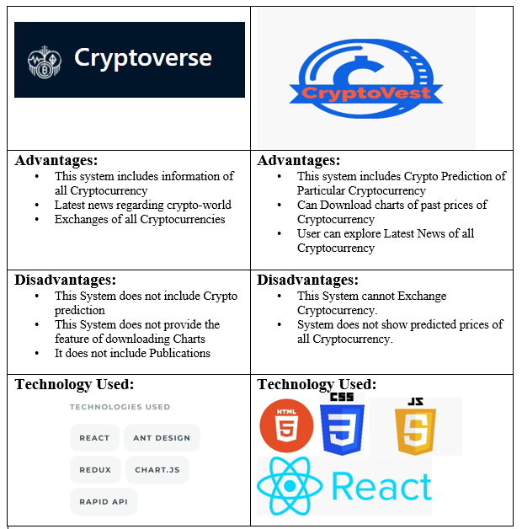
4. Literature Survey

Slide 7
5. Proposed System
Our system provides user to search for various types of cryptocurrency available in the world.
In our system user can see the real-time prices of the cryptocurrency.
Ability to download graphs of past cryptocurrency prices.
Providing the latest news about the crypto world.
Providing statistics regarding particular currency exchanges worldwide.

Slide 8
6. Outcome of Project
Helps users to retrieve information about cryptocurrencies.
Enabling users to gain knowledge about new currencies introduced in the market
Users are able to get current market price of all cryptocurrencies.
Users will get All time high value and All time low value about particular cryptocurrency.
User can see Predicted prices of Particular Cryptocurrencies.

Slide 9
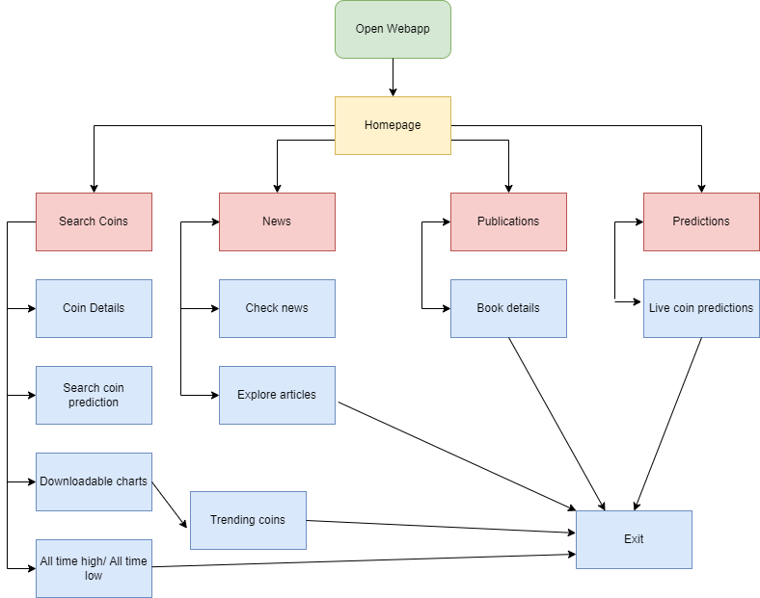
7. Block Diagram(System Flow):

Slide 10
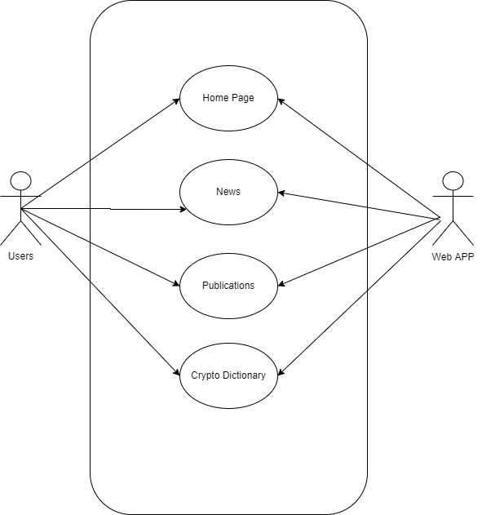
8. Use Case :

Slide 11
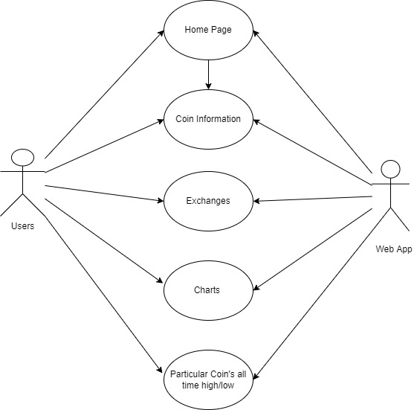
8. Use Case of Homepage:

Slide 12





9. Technology Stack:
The Technology Stack we used in the Project are:
Language Used :- HTML, CSS, JavaScript, JQuery
2. API ( Application Programming Interface) :- Coingecko
3. Framework :- React

Slide 13
10. Suggestion In Review-1
GUI Changes
Literature Survey

Slide 14
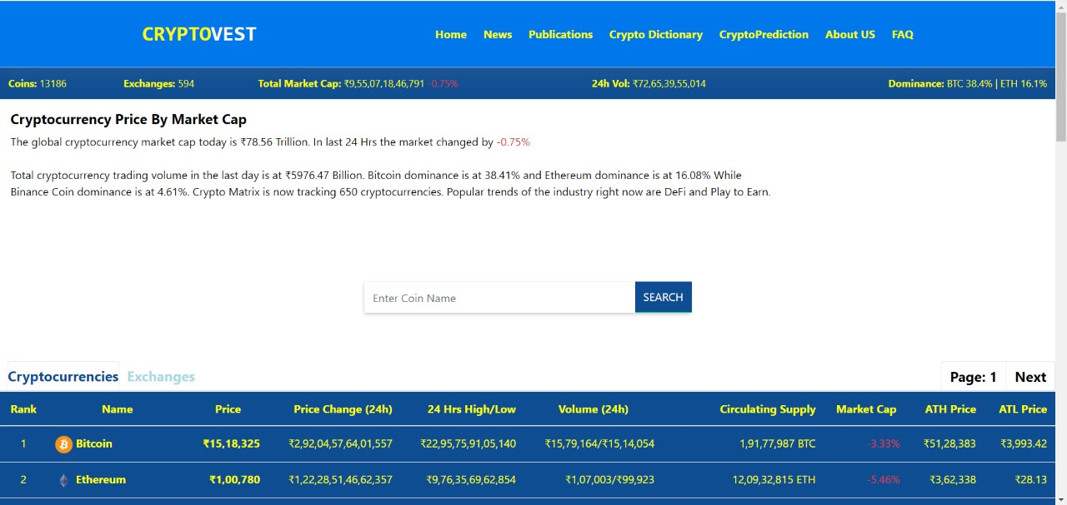
11. Result and Discussion
Home Page

Slide 15
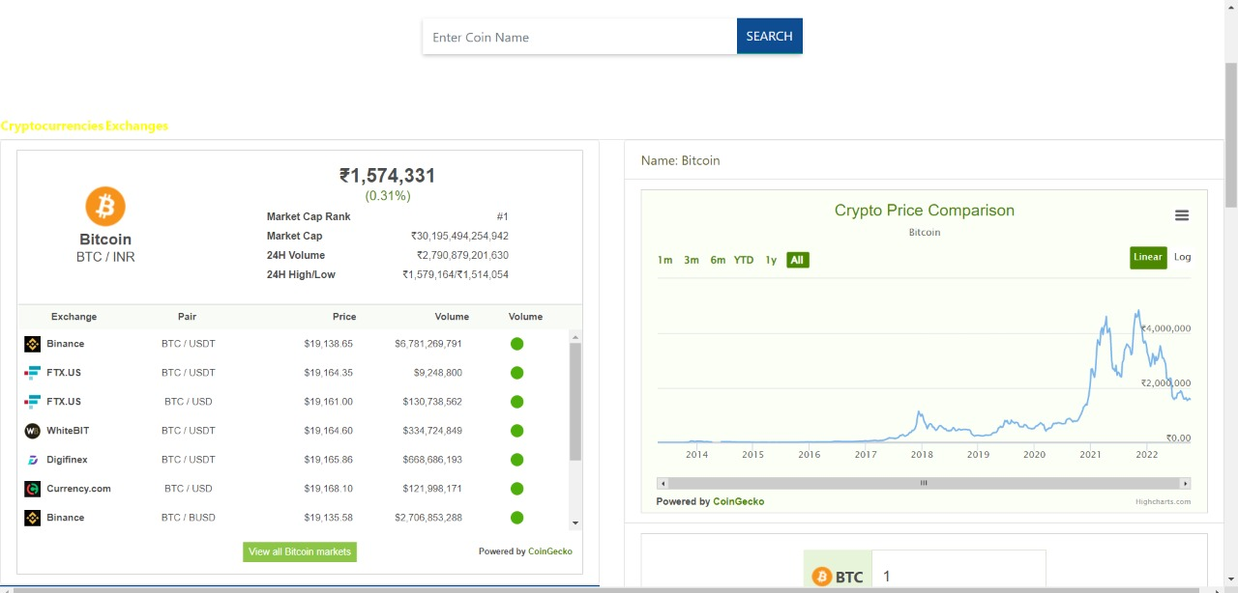
Coin Page

Slide 16
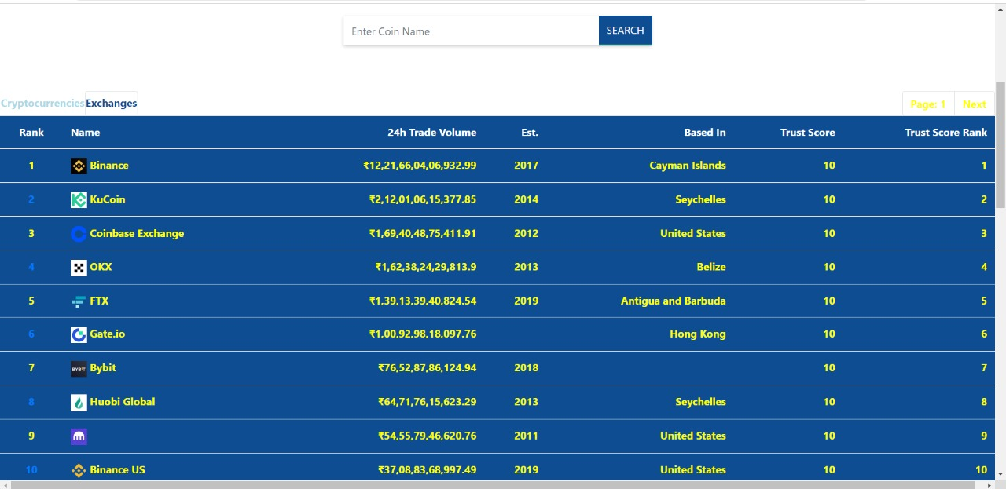
Exchange Page

Slide 17
12. Conclusion and Future Scope
CONCLUSION :
A User who is Beginner as well as Experienced can use CryptoVest to Explore Cryptocurrencies.
Both Users can use CryptoVest according to their need.
FUTURE SCOPE :
A User Can see predicted values of all Cryptocurrencies
A User can Exchange Cryptocurrency through CryptoVest.
User can maintain his well defined portfolio

Slide 18
References
www.react.com
www.nodejs.com
www.coingecko.com
www.researchgate.com
https://www.youtube.com/watch?v=9DDX3US3kss&t=3s

Slide 19
Thank You...!!

